Slide 1
QUANTUM CHEMISTRY
DR. J. MADHAVAN
Assistant Professor
Department of Chemistry
Thiruvalluvar University, Vellore-632 115

Slide 2
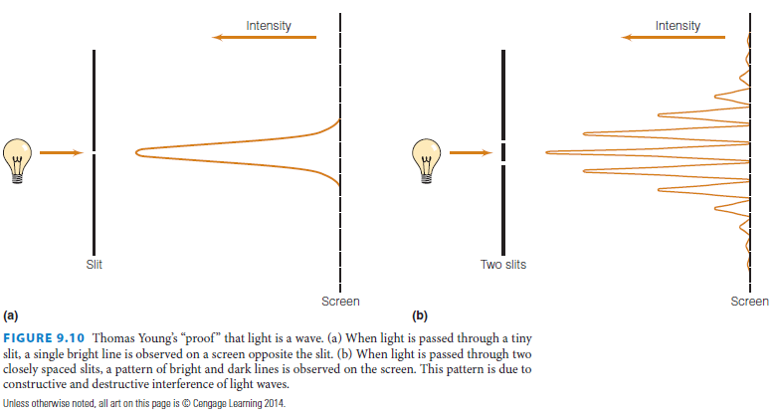
“What is light?’’
Some evidence showed that light acted as a particle, and some evidence indicated that light acted as a wave.
Thomas Young’s double-slit experiment in 1801 (Figure 9.10) demonstrated conclusively the diffraction patterns caused by constructive and destructive interference of light. It seemed clear that light was a wave of extremely small wavelength, about 400027000 A° depending on the color of the light.
(One angstrom, 1 A° , equals 10210 meters. Anders Jonas Ångström was a Swedish physicist and astronomer.)

Slide 3
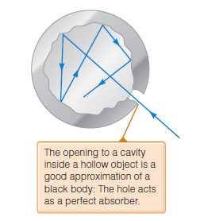
After the introduction of the spectroscope, scientists began studying the interaction
of light and matter to understand how light was emitted and absorbed by
bodies of matter. Solid bodies heated to glowing emitted a continuous spectrum
composed of all wavelengths of light. The intensities of the different wavelengths
of light emitted were measured and plotted. The intensity distribution presented
much fuel for debate.
The easiest bodies of matter to treat theoretically were called blackbodies.
A blackbody is a perfect absorber or emitter of radiation. The distribution of
absorbed or emitted radiation depends only on the absolute temperature, not on
the blackbody material. A blackbody can be approximated as a small, hollow cavity
with only a tiny hole for light to escape (Figure 9.11). Light emitted by blackbodies
is sometimes referred to as cavity radiation.
Figure 9.11 A good approximation of a blackbody is made by constructing a cavity with a very small hole in it. Defined as a perfect absorber or emitter of radiation, blackbodies do not absorb or emit radiation equally at all wavelengths. This diagram shows a blackbody’s ability to absorb all radiation. Light that enters the small hole of the blackbody reflects off the inside surfaces, but has a very small chance of escaping the cavity before it is absorbed.

Slide 4
When scientists began measuring the intensity or “power density” of light given
off as a function of wavelength I(l) at various temperatures, they made some interesting
observations:
1. Not all wavelengths of light are emitted equally. At any temperature, the intensity of emitted light approaches zero as the wavelength approaches zero. It increases to some maximum intensity Imax at some wavelength, and then decreases back toward zero as the wavelength increased. Typical plots of the power density versus l at specific temperatures are shown in Figure 9.12.
2. The total power per unit area, in units of watts per square meter (W/m2), given off by a blackbody at any temperature is proportional to the fourth power of the absolute temperature:
where s is the Stefan-Boltzmann constant, whose value is determined experimentally to be 5.6705 x 10-8 W/m2 .K4. This relationship was measured experimentally by the Austrian physicist Josef Stefan in 1879 and deduced by his countryman Ludwig Boltzmann several years later.
3. The wavelength at the maximum intensity, lmax, varies indirectly with temperature such that
where the value of this constant is approximately 2898 micrometer
K; the wavelength is in units of micrometers.
This equation, enunciated by Wien in 1894, is known as the Wien displacement law. (This relationship is still used today to estimate the temperature of hot bodies, using an optical device called a pyrometer to determine intensities of light given off at certain wavelengths of light.)

Slide 5
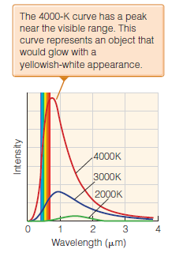

The most successful of these started with an assumption by the English baron Lord John W. S. Rayleigh that light waves come from tiny oscillators within the blackbody. Rayleigh assumed too that the energy of the light wave is proportional to its wavelength, so that the smaller wavelengths would be emitted more easily by these tiny oscillators. Using the equipartition principle from the kinetic theory of gases (see Chapter 19), Rayleigh proposed and later James Hopwood Jeans corrected a simple formula for the infinitesimal amount of energy per unit volume dr (also known as an energy density) in a blackbody in a wavelength interval dl as
Rayleigh-Jeans law.
k is Boltzmann’s constant, l is the wavelength, and T is the absolute temperature. The total energy per unit volume at a particular temperature is given by the integral of the above expression.
Figure The experimentally determined behavior of blackbodies. This plot shows the intensity of light at different wavelengths for different temperatures of the blackbody. Explaining these curves theoretically was a major problem for classical mechanics.

Slide 6
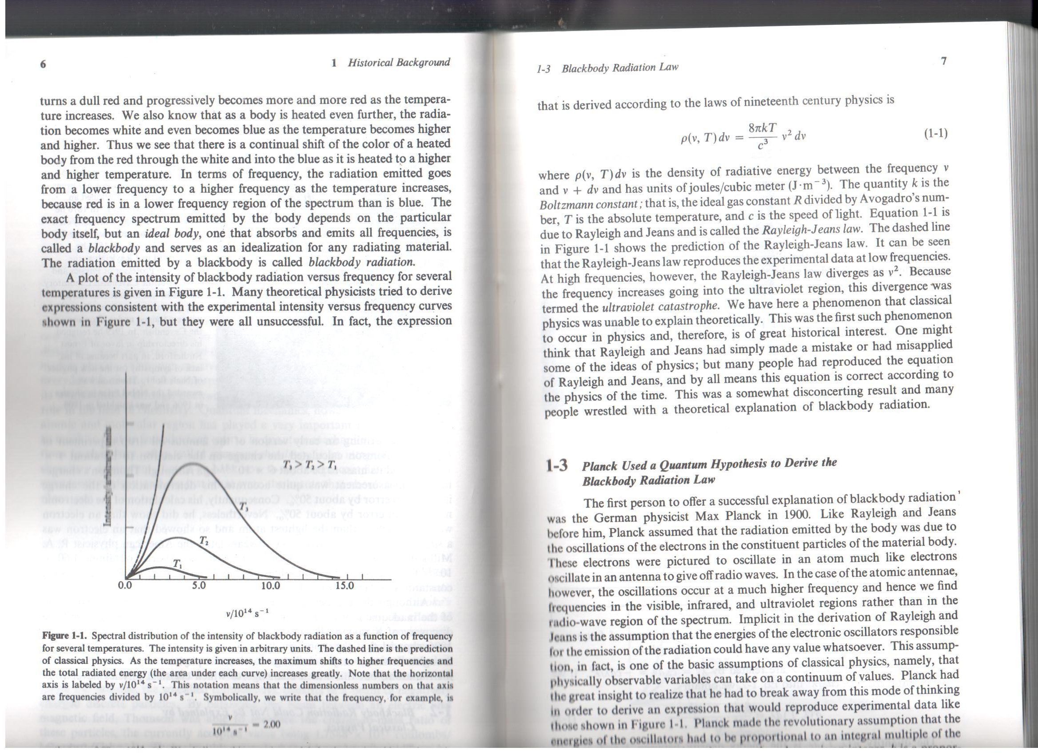
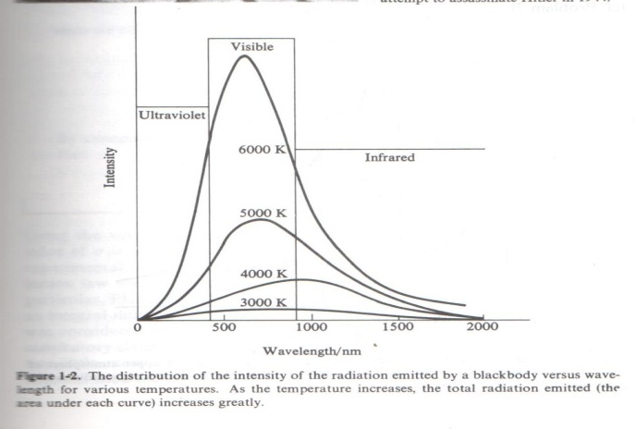
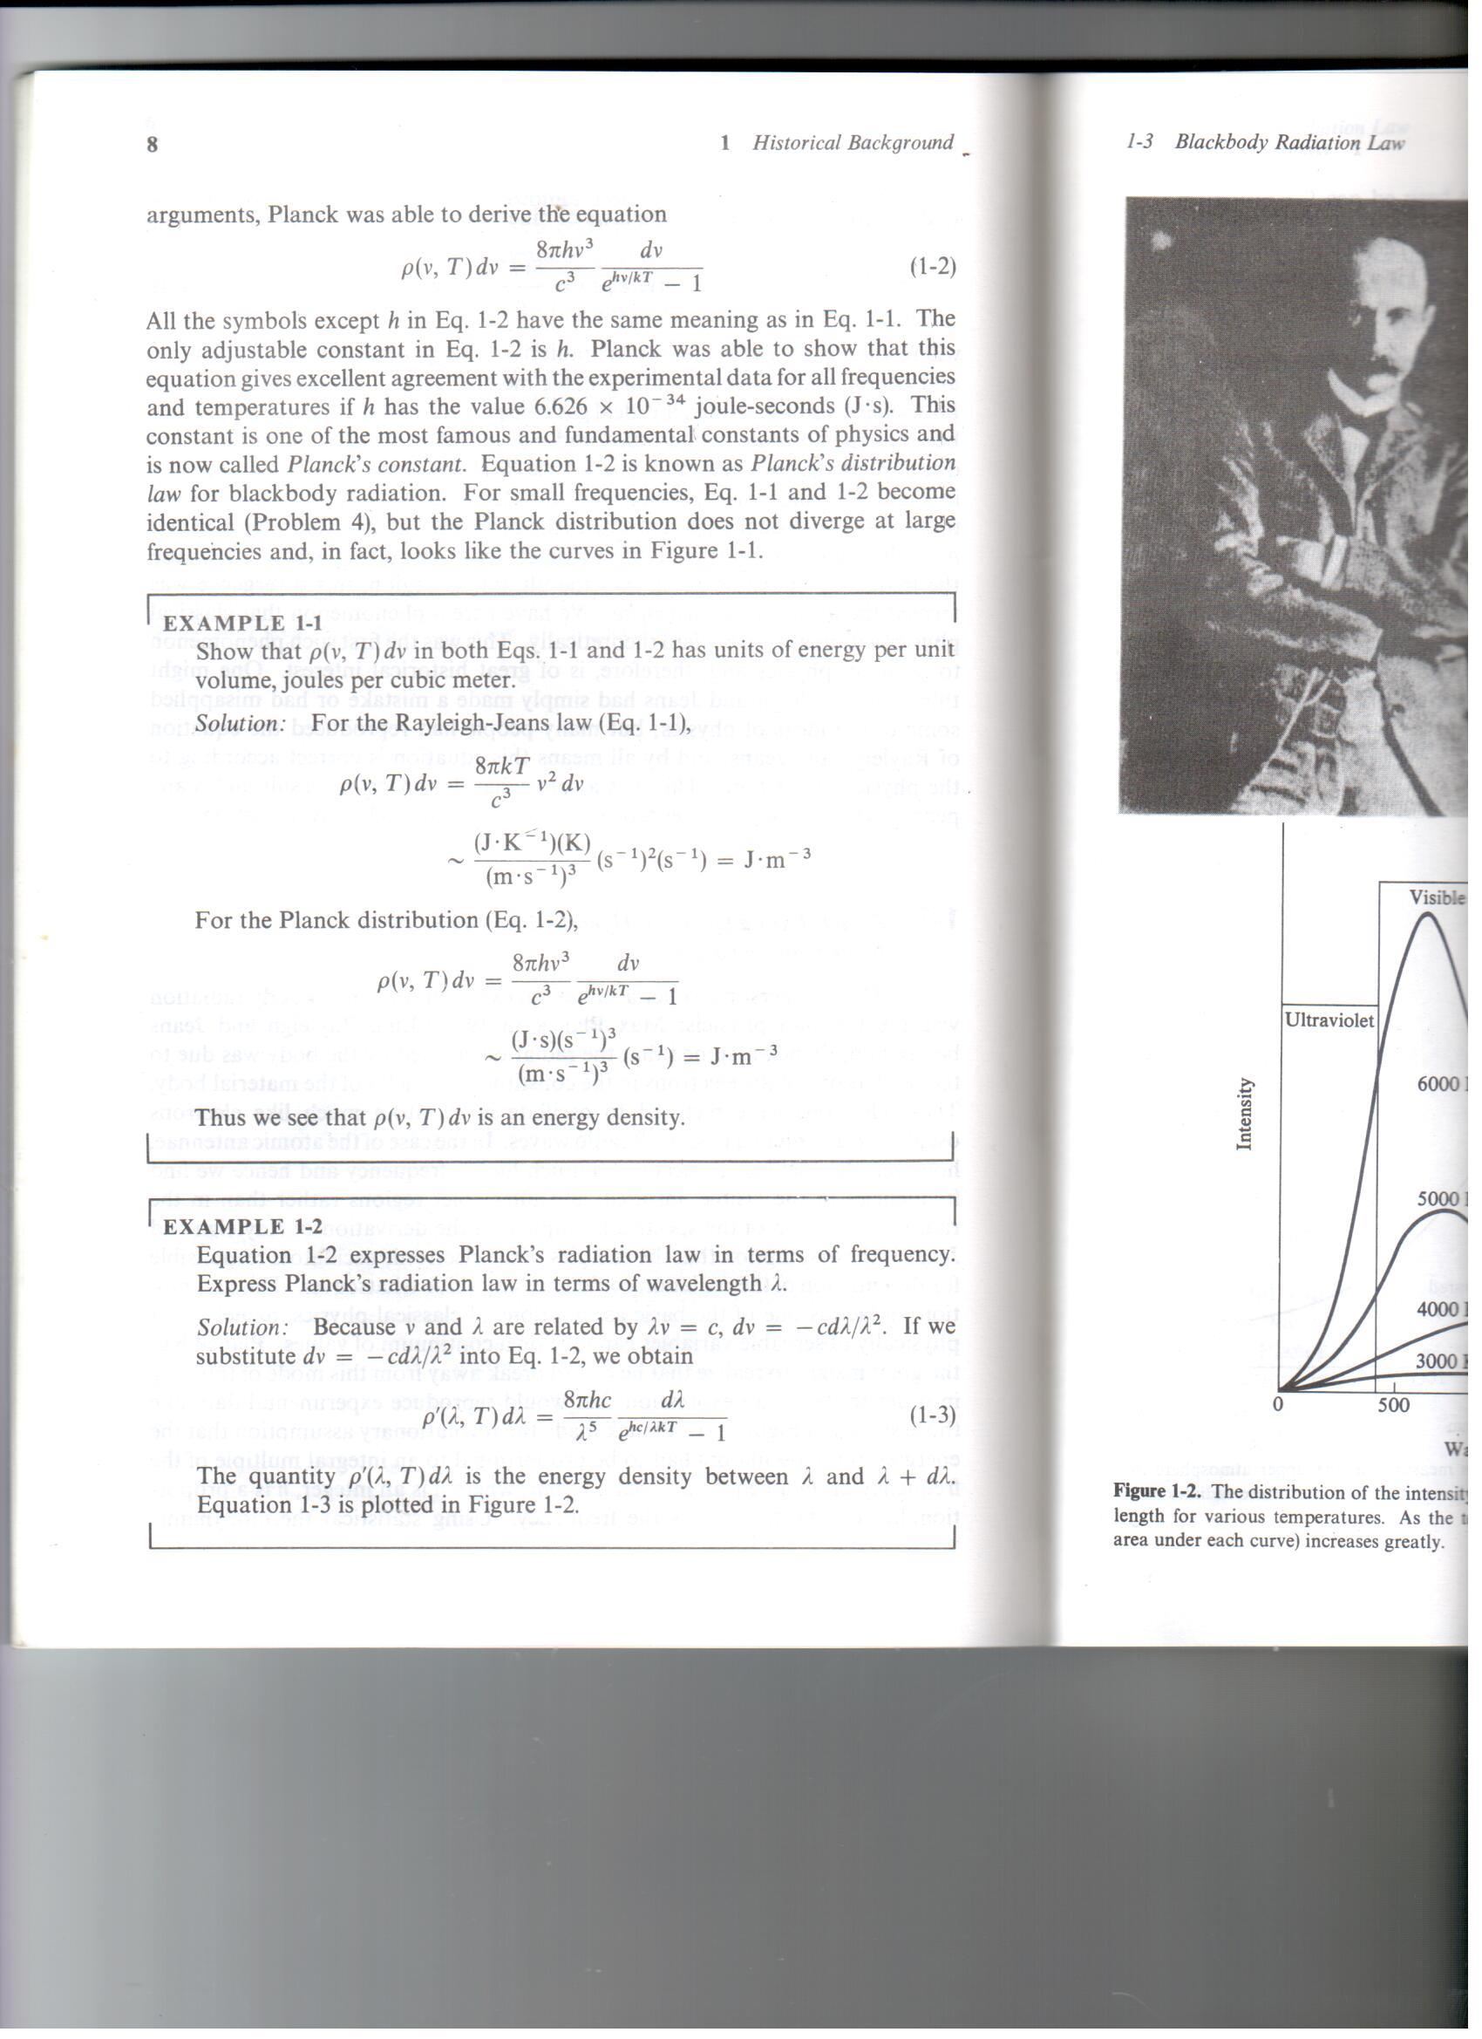

Slide 7
Limitations of Rayleigh-Jeans law. It fits the experimentally observed blackbody
intensity curves such as those shown in Figure 9.12, but only at high temperatures
and only in long-wavelength regions of the spectrum. Most problematic is
the short-wavelength intensity predicted by the Rayleigh-Jeans law: It indicates that
as the wavelength gets smaller, the energy density dr given off in the wavelength
interval
dl goes up by a factor of the fourth power. (This is a consequence of the l⁴ term in the denominator of equation 9.20.) The final result is shown in Figure 9.13, which compares the Rayleigh-Jeans equation with the known blackbody behavior:
The intensity predicted by the Rayleigh-Jeans law approaches infinity as the wavelength
of the light approaches zero. In terms of Rayleigh’s assumption, it suggests
that the smaller the wavelength of the light, the lesser the energy of the light, and
so the easier it should be for a blackbody to radiate that light. Infinite intensities,
however, are impossible to obtain! It was obvious from experiments of the time that
the intensity of light at shorter wavelengths does not approach infinity. Instead, the
intensities tapered off to zero as the wavelength shortened. The Rayleigh-Jeans law
predicts an ultraviolet catastrophe that does not occur.

Slide 8
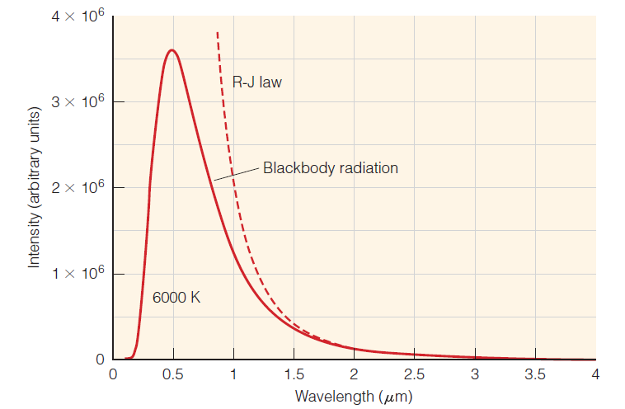
Early attempts at modeling the behavior of a blackbody included the Rayleigh-Jeans
law. But as this plot illustrates, at one end of the spectrum the calculated intensity grows upward to infinity, the so-called ultraviolet catastrophe.

Slide 9
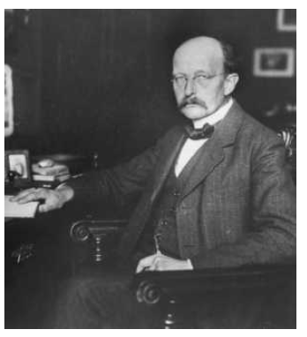


Quantum Theory
The first step to a better understanding of the universe came in 1900 when the German physicist Max Karl Ernst Ludwig Planck proposed a relatively simple equation to predict the intensities of blackbody radiation. There is some speculation that Planck came up with an equation that fit the data and then Reasoned out a justification, rather than supposing a new idea and working it up to
see what would happen.
Planck treated light as interacting with electric oscillations in matter. He supposed that the energy of these oscillations was not arbitrary, but proportional to their frequency ν:
Planck called this amount of energy a quantum, and we consider that the energy of the oscillator is quantized. According to classical mechanics, a system can absorb or emit any amount of energy, but Planck’s hypothesis energy emitted by a black body is restricted to an integral number of certain minimum E.
Planck’s radiation distribution law
Max Karl Ernst Ludwig Planck (1858–1947).
where l is the wavelength of the light, c is the speed of light, k is Boltzmann’s
constant, and T is the absolute temperature and h is Planck’s constant. Its
value is about 6.626 x 10⁻³⁴ J.s

Slide 10
Planck proposed that a black body chamber was filled not only with radiation but also with molecules of perfect gas and dipole oscillators of molecular dimensions constituting the lack body absorbed energy from the radiation and transferred it partily or wholly to the gas molecules when the later collided with them.

Slide 11


Planck’s law in terms of emittance (infinitesimal power per unit area
(Note: power is defined as energy per unit time))
is written as follows
This Planck’s equation predicts the intensity of blackbody radiation at all wavelengths and all temperatures. This formula had no theorectical background and was obtained empirically by trial and error method to explain the observed results
Planck’s equation can also be integrated from 0 0 to ∞ in a straightforward
manner to obtain
Power flux is proportional to the fourth power of the absolute temperature. That is, Planck’s equation produces the Stefan-Boltzmann law (equation 9.18) and predicts the correct value, in terms of fundamental constants, of the Stefan-Boltzmann constant σ. This was another prediction of Planck’s derivation that was supported by observation

Slide 12
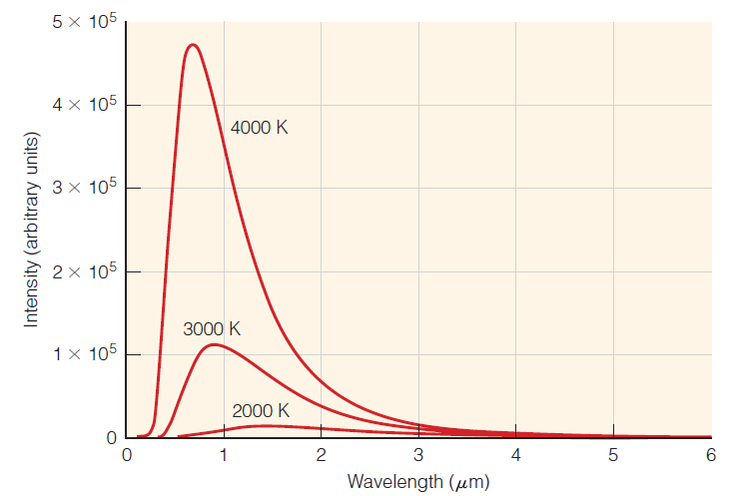
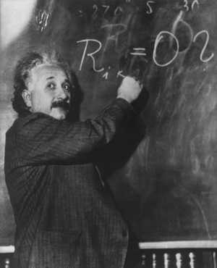

A plot of the intensity of radiation versus wavelength at different temperatures for
a blackbody, assuming Planck’s radiation law is correct. Predictions based on Planck’s law agree with experimental measurements, suggesting a correct theoretical basis
many scientists (including Planck himself, initially) suspected that Planck’s equations were more of a mathematical curiosity and did not have any physical importance. Planck’s quantum theory was a mere mathematical curiosity for only five years.
In 1905, the 26-year-old German physicist Albert Einstein (Figure 9.16) published a paper about the photoelectric effect. In this paper, Einstein applied Planck’s quantized-energy assumption not to the electrical oscillators in matter but to light itself. Thus, a quantum of light was assumed to be the energy that light has, and the amount of that energy is proportional to its frequency

Slide 13

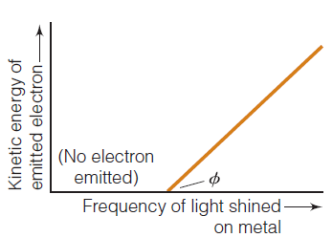
Einstein made several assumptions about the photoelectric effect:
1. Light is absorbed by electrons in a metal, and the energy of the light increases
the energy of the electron.
2. An electron is bound to a metal sample with some characteristic energy.
When light is absorbed by the electron, this binding energy must be overcome
before the electron can be ejected from the metal. The characteristic binding
energy is termed the work function of the metal and is labeled f.
3. If any energy is left over after overcoming the work function, the excess energy
will be converted to kinetic energy, or energy of motion.
Kinetic energy has the formula ½ mV². By assuming that each electron absorbs the energy of one quantum of light, Einstein deduced the relationship
If hv is less than phi, photon will not have sufficient energy to eject the electron from the metal and no photoelectric effect would be observed.
A simple diagram of the kinetic energy of an ejected electron (directly related to its speed) versus the frequency of light shined on a metal sample. Below some threshold frequency of light, no electrons are emitted. This threshold frequency, f, is called the work function of the metal.
The higher the frequency of light, the more kinetic energy the emitted electron has, so the faster it moves. Einstein related the frequency of the light to the kinetic energy of the ejected electrons using Planck’s ideas about quantized energies, and in doing so provided an independent physical basis for Planck’s radiation law as well as the concept of the quantization of light energy.

Slide 14
where the energy of the light, hν, is converted into overcoming the work function
and into kinetic energy. Needless to say, if the energy of the light is less than the
work function, no electrons will be ejected because kinetic energy cannot be less
than zero. The work function therefore represents a threshold energy for the photoelectric effect. Because the intensity of light is not part of the equation, changing
the intensity of light does not change the speed of the ejected electrons. However,
increasing the light intensity means a greater number of electrons are ejected. Also,
if the frequency of the light on the sample were increased, the kinetic energy of
the ejected electrons would increase (meaning that their velocity would increase),
Because the work function f is a constant for a particular metal.
Planck’s and Einstein’s work reintroduced the idea that light can be treated as a
particle—a particle having a certain amount of energy. There was no denying the
fact that light acts like a wave. It reflects, refracts, interferes as only a wave can.
But there can also be no denying that light has particle properties. Light can be
treated as a stream of individual particles, each of which carries a certain amount
of energy whose value is determined by its wavelength.

Slide 15
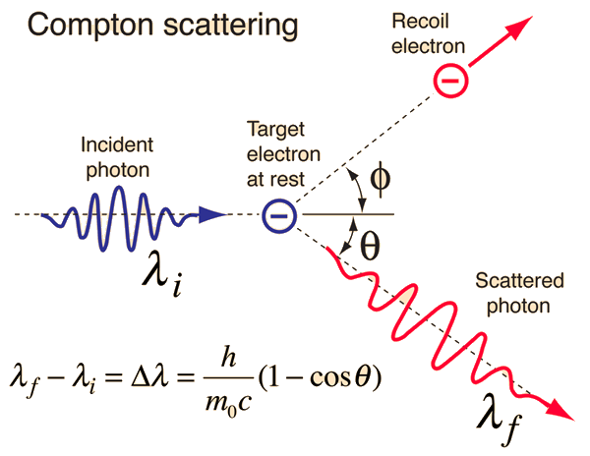
Compton Effect
More evidence of the particle nature of light came in 1923 when Arthur
Compton showed that the scattering of monochromatic (same-wavelength; literally, “same-color”) X rays by graphite caused some of the X rays to shift to a slightly longer wavelength. The only way to account for this was to assume that the monochromatic X rays acted as a particle with a specific energy, and that the collision of a particle of light with an electron caused energy to be transferred between the two particles, lessening the energy of the light particle and therefore increasing its wavelength. (There were also momentum considerations)
In 1926, G. N. Lewis proposed the word photon as the name for a particle of light.
Compton Shift = Δλ

